Slide 1



Apache Hive Interview Questions
Hive Architecture

Slide 2
What is Hive
Apache Hive is a data warehouse software which facilitates reading, writing, and managing large datasets residing in distributed storage using SQL.
Apache Hive is a data warehouse system built on top of Hadoop and is used for analyzing structured and semi-structured data.
It makes job easy for performing operations like
Analysis of huge datasets
Ad-hoc queries
Data encapsulation

Slide 3
Hive Client
Thrift App
JDBC App
ODBC App
Hive Thrift Client
Hive JDBC driver
Hive ODBC driver
Hive Services
Hive Web Interface
Hive Server
CLI
Hive Driver
Metastore
Apache Derby DB
Compute and resource management
Apache TEZ
Apache Spark
YARN
MapReduce
Distributed Storage
HDFS

Slide 4
Hive Component Architecture
Major components of Apache Hive :
Hive Clients – Apache Hive supports api(s) for languages like C++, Java, Python etc. using JDBC, Thrift and ODBC drivers.
Hive Services – Hive provides various services like web Interface, CLI, Driver and metastore services to perform queries.
Compute and Resource Management – Hive internally uses Hadoop MapReduce framework to execute the queries, along with other execution engines like Apache Spark and Tez.
Distributed Storage – As seen above that Hive is built on the top of Hadoop, so it uses the underlying HDFS for the distributed storage.

Slide 5
Data Flow In Hive
Execution Engine
9
CLI/
CLIENT
6
HADOOP
1
Driver
7
MapReduce
HDFS
8
2
5
Compiler
3
Metastore
4

Slide 6
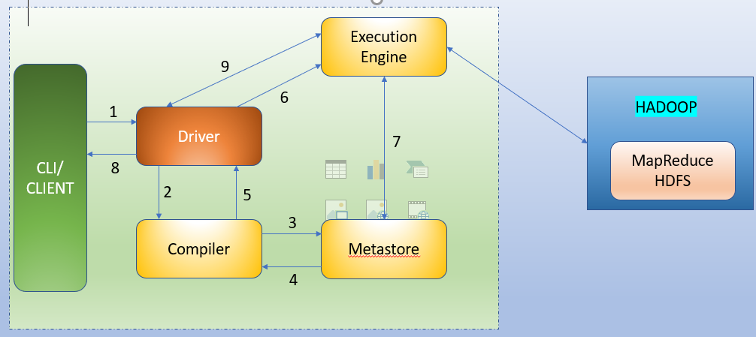
Data Flow in Hive
When CLI or Client calls the execute interface to the Driver, the driver creates a session handle for the query. Then it sends the query to the compiler to generate an execution plan.
The compiler needs the metadata. So it sends a request for getMetaData. Thus receives the sendMetaDatarequest from Metastore.

Slide 7
Data Flow in Hive
Now compiler uses this metadata to type check the expressions in the query. The compiler generates the plan which is DAG of stages with each stage being either a map-reduce Job, a metadata operation or an operation on HDFS

Slide 8
Data Flow in Hive
Now execution engine submits these stages to appropriate components. Each task the deserializer associated with the table produces intermediate outputs. Once it generates the final output,it is writen to a temporary HDFS file through the serializer. Then move the final temporary file to the table’s location for DML operations.
Execution engine directly read the contents of the temporary file from HDFS via driver and query execution is performed and results are returned back to driver.

Slide 9
Thanks and do subscribe to my channel

